Slide 1
Interview
Warmup AI
CMPE 280 : Prof. Xiuduan Fang
Divyam Savsaviya
Nevil Padariya
Nagaraj GK
Notes:
As computer engineering students, we all know the feeling of staring at a blank IDE or struggling to articulate our thoughts during a technical interview. We built this platform to bridge the gap between solitary practice and the high-pressure environment of a real interview."

Slide 2
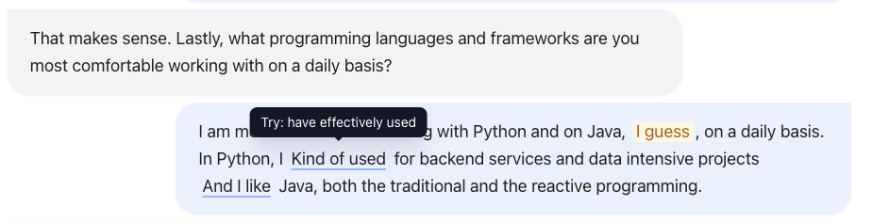
Why
CMPE 280 : Prof. Xiuduan Fang
01
02
03
Technical interviews are stressful, solitary experiences with high stakes and delayed feedback
New graduates, career switchers, and professionals anxious about "rust."
Practice without feedback reinforces bad habits. Candidates need a safe space to fail and iterate.
Notes:
“Tech interviews are nerve-wracking and isolating—you’re on the spot, the stakes feel high, and real feedback rarely comes in time to help. Whether you’re a new grad or a seasoned engineer, you worry about sounding rusty. Practicing alone just bakes in bad habits. We built a safe practice loop with a calm, distraction-free UI/UX—large readable captions, color-coded highlights for fillers or weak phrasing, and accessible controls—so you can immediately see where to tighten your answers and build confidence in a way that feels supportive, not punitive.”

Slide 3
AI Voice agent interviews you and gives instant feedback
CMPE 280 : Prof. Xiuduan Fang
01
Generates custom questions from your actual resume and background.
02
sub-500ms latency feels like a human conversation.
03
Clean UI UX with no distractions, focused hierarchy, and semantic color feedback.
Notes:
“What we built is an AI voice interview coach that feels like a real interviewer and a friendly tutor. It asks role- and JD-aware questions, listens in real time, and immediately shows you what to fix—visually and clearly. The experience is designed for calm focus: big, readable captions, high-contrast, distraction-free layout, and fully keyboard-accessible controls. After each answer, your own words are annotated in-line: soft yellow for fillers, blue underlines for weak phrasing, and gentle red for critical misses, with quick tips on hover/focus. Score tiles highlight confidence, clarity, and knowledge depth, but the transcript is the star—color-coded highlights that pinpoint exactly where to tighten your response. Everything—spacing, color, type, and motion—stays consistent with the warm, minimalist “interview warmup” theme, so the UI guides you without ever getting in the way.”

Slide 4
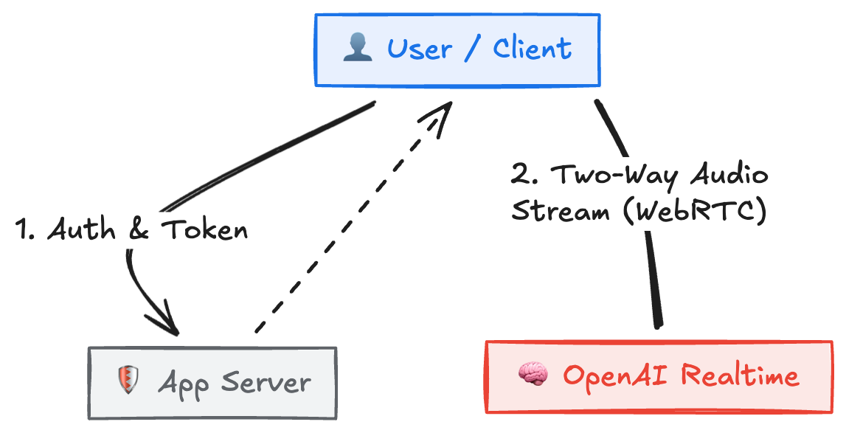
How
Frontend
Backend
AI/API
State Management:
React (Vite) + Tailwind CSS
Node.js + Express
Persistent full-duplex audio stream via webRTC
(no traditional HTTP request/response loop)
React useRef buffers for holding audio streams without re-renders

Slide 5
Metrics
CMPE 280 : Prof. Xiuduan Fang
99
Lighthouse Accessibility per key flow
reflects contrast + aria-labels + keyboard nav,
100
Performance from Vite + minimal lazy loading of payloads

Slide 6
Lessons learned and Future work
CMPE 280 : Prof. Xiuduan Fang
Traditional pipelines (Transcribe -> LLM -> TTS)
Switched to OpenAI Realtime API (WebRTC) to achieve true <500ms conversational latency.
Long-term Journeys
Enables personalized learning paths instead of one-off practice sessions.
Tone Analysis
Future plan to add full speech-based interview modes with real-time tone and sentiment analysis.

Slide 7
Thanks
Before you interview,
get warmed up

Slide 8
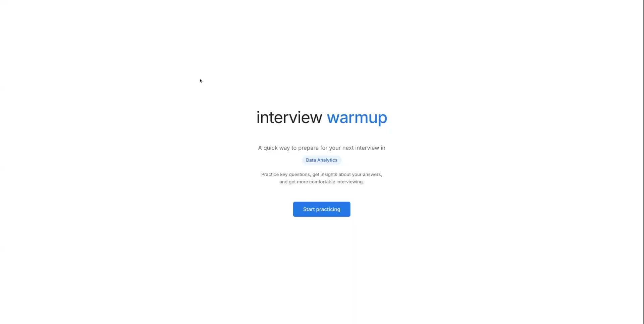
CMPE 280 : Prof. Xiuduan Fang
Date: 12/11/2025

Slide 9
Metrics Docs: https://drive.google.com/file/d/1v98Q5sfKRA_Rb6ZHY3HAbQySK8ZublGE/view?usp=sharing

